Slide 1


Making Private Data Open and Enhancing Decision-Making through Digital Atlases
Prof Helen Thompson, Prof Kerrie Mengersen
Queensland University of Technology
Open Data Science Conference 2023
helen.thompson@qut.edu.au k.mengersen@qut.edu.au

Slide 2
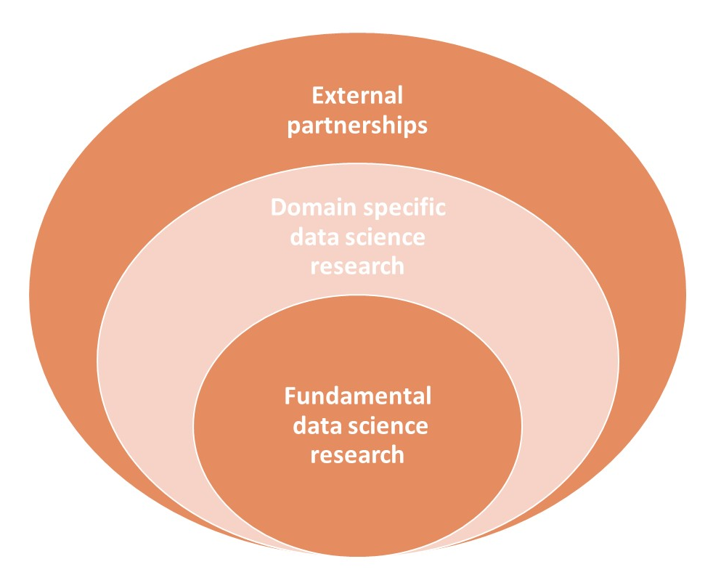


130+ Researchers
100+ HDRs
5 Faculties
20 Partner Organisations
5 Core Programs
11 Applied Domains
Data for Discovery
Models and Algorithms
Complex Data Analytics
Responsible Data Science
Human-Centred AI

Slide 3

ACEMS
AMSI
Swinburne
Monash
RMIT
Queensland
Data61
Victoria
NSW
UTS
Australian Data Science Network
UNSW
Professional Societies
Victoria
UQ
Wollongong
QUT
Western Australia
ACT
South Australia
Melbourne
Uni SA
Deakin
Adelaide
La Trobe

Slide 4




Case Study: ACA
The Australian Cancer Atlas

Slide 5
Evidence-based Decision-making Platforms
Modern decision-making is commonly supported by digital platforms: e.g., dashboards, atlases.
Pro: Encourages open, complete data
Pro: Allows for more in-depth engagement and interpretation than static reports or articles
Pro: Disrupts the traditional Plan, Do, Act cycle
Con: ... open, complete...
Con: ...interpretation...
Formulate
Question
Make
Decision
Collect
Data
Interpret
Results
Data
Processing
More complex data inspection
Analyse

Slide 6
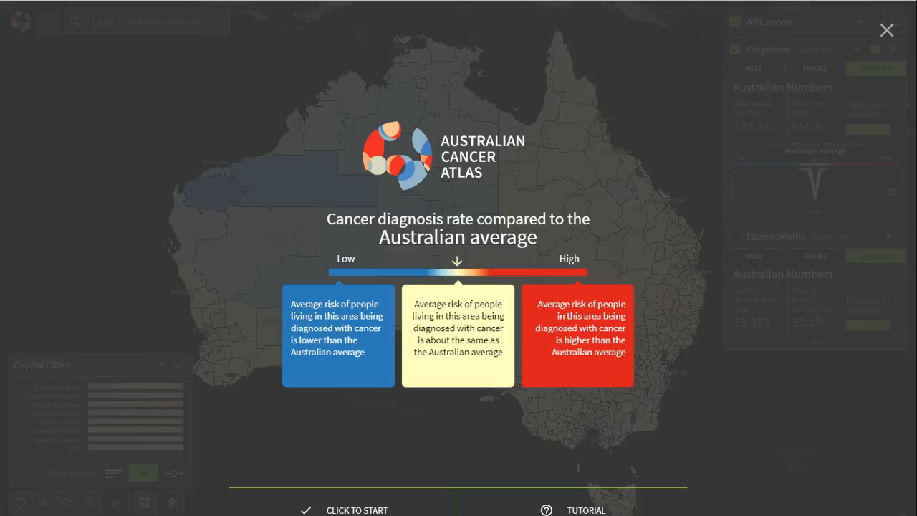

Slide 7
Themes of this presentation
Creating open data
From private to modelled data (Susanna Cramb, ACA team)
Federated learning alternative (Conor Hassan, Rob Salomone)
2. Creating complete data
From survey to census data (James Hogg)
3. Creating interpretable data
Visualisations (Sarah Goodwin, Stephanie Kobakian, Dianne Cook)
Value-add: clusters and indices (Wala Areed, Aiden Price)

Slide 8
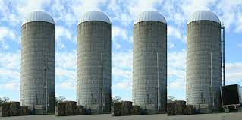
1. The Challenge of open data
Private
Sensitive
Siloed

Slide 9
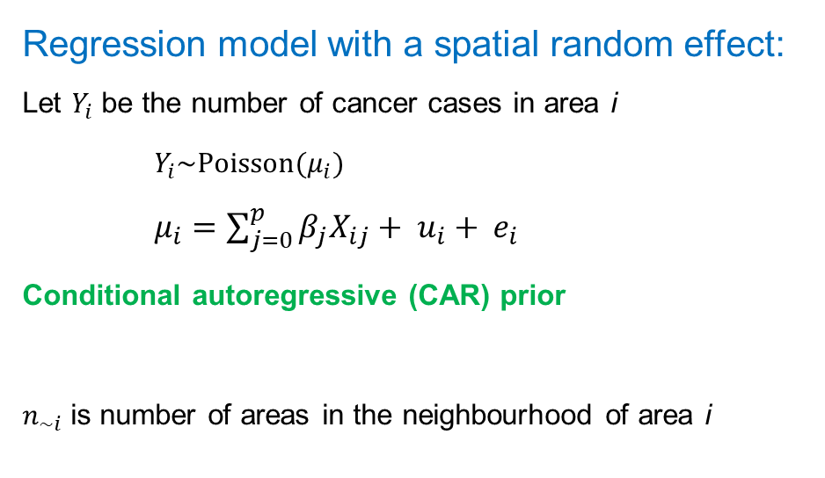
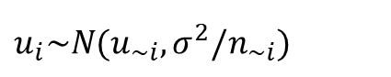
Alternative 1: Bayesian spatial model
Regression model with a spatial random effect: Let $Y_{i}$ be the number of cancer cases in area i
$Y_{i}\sim Poisson(μ_{i})$ $μ_{i}=\sum_{j=0}^{p}{{β_{j}X}_{ij}}+ u_{i}+ e_{i}$
Conditional autoregressive (CAR) prior
$n_{\sim i}$is number of areas in the neighbourhood of area i
 |  | Area i
$u_{i}\sim N(u_{\sim i},σ^{2}/n_{\sim i})$

Slide 10
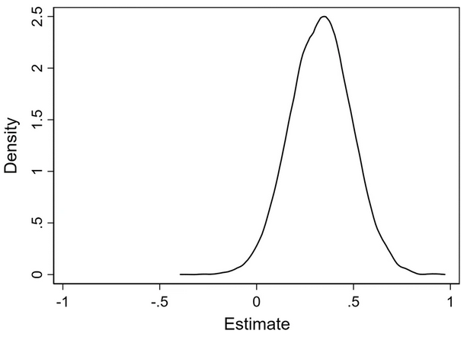
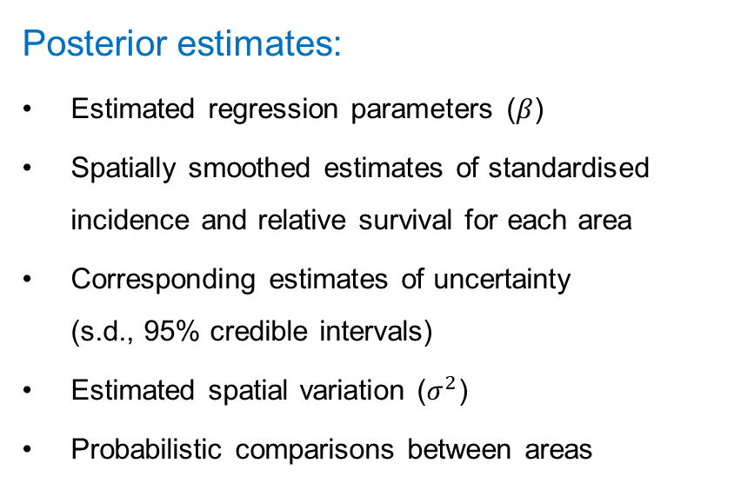
Bayesian spatial model – open (modelled) data
Posterior estimates:
Estimated regression parameters ($β$)
Spatially smoothed estimates of standardised incidence and relative survival for each area
Corresponding estimates of uncertainty (s.d., 95% credible intervals)
Estimated spatial variation ($σ^{2}$)
Probabilistic comparisons between areas
 |  | Area i
Insert posterior
Distribution here

Slide 11
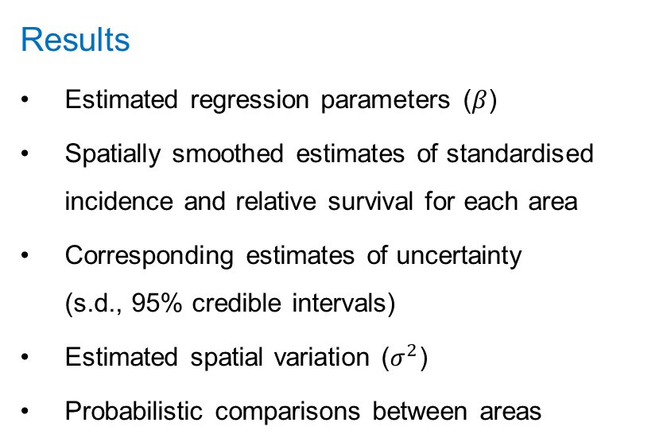
Bayesian spatial model - inferences
Results
Estimated regression parameters ($β$)
Spatially smoothed estimates of standardised incidence and relative survival for each area
Corresponding estimates of uncertainty (s.d., 95% credible intervals)
Estimated spatial variation ($σ^{2}$)
Probabilistic comparisons between areas
 |  | Area i
Insert posterior
Distribution here

Slide 12
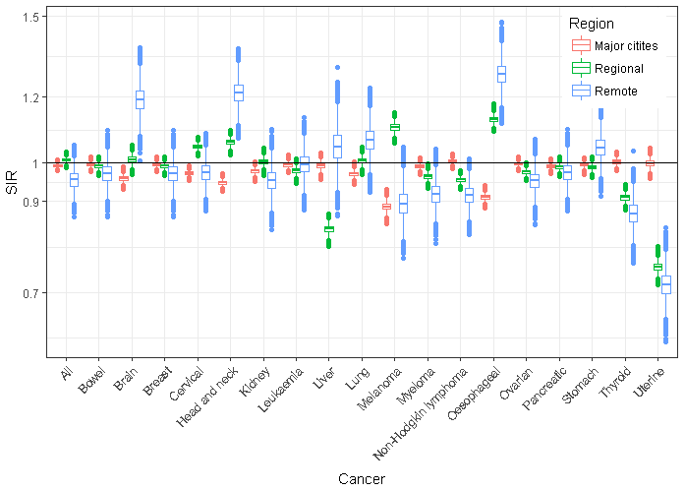
Inferences: Spatial inequalities in incidence - females

Slide 13
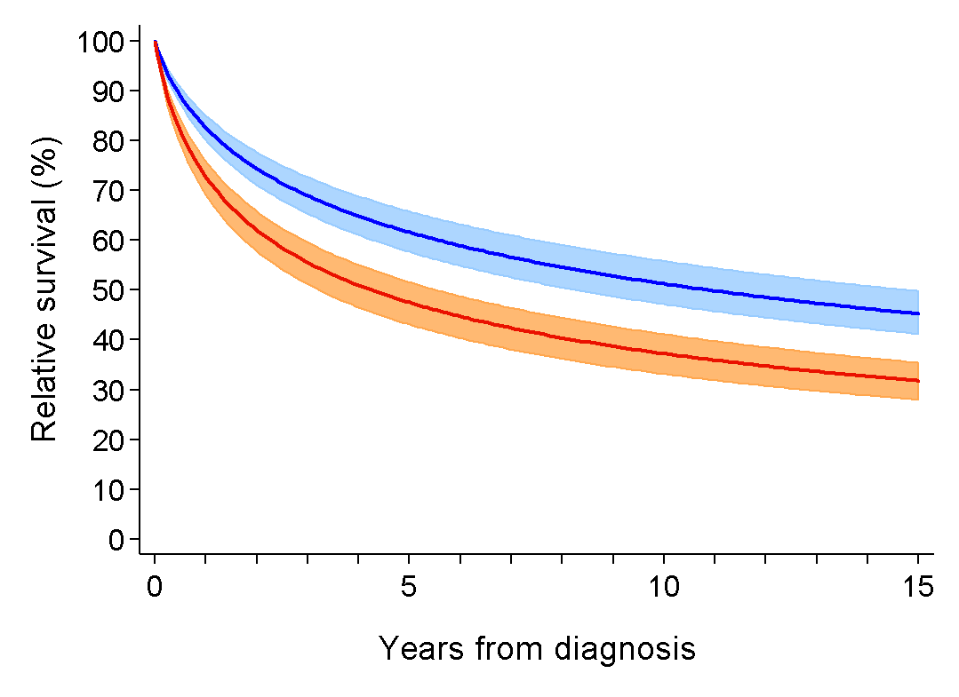
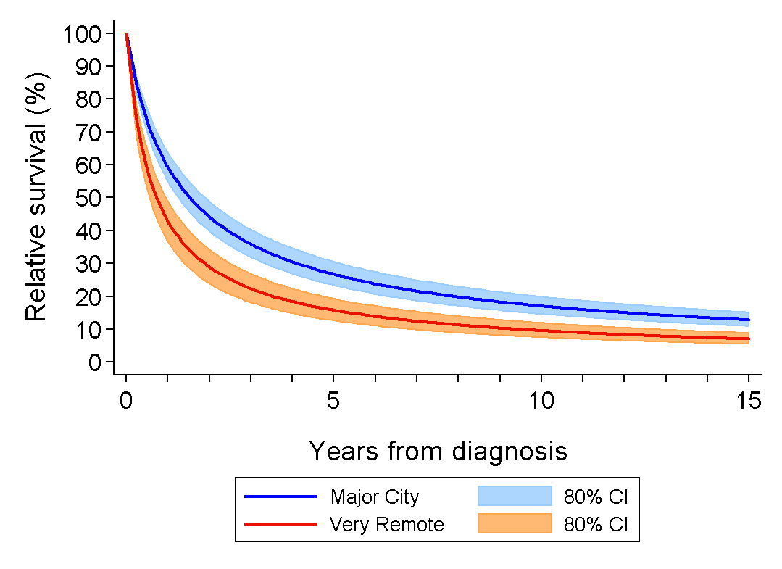
Inferences: Colorectal cancer relative survival curves

Slide 14
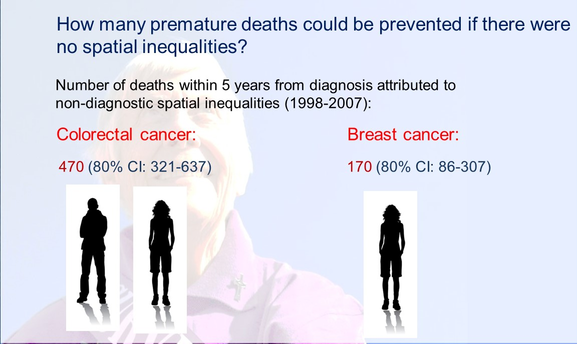

Slide 15
Alternative 2: Federated learning
“Analysis of data without the data leaving the source”
Avoids ethical, legal, political, administrative and computational barriers to combining data from multiple sources
Increases control
Potential to improve data quality & timeliness
Increases inferential capability from small or dispersed datasets

Slide 16
FL in the context of Digital Data Platforms
Cloudera, 2018
Healthcare: “save lives and generate huge value”
Predictive maintenance: “train a better model with less expense”
“… easier, safer and cheaper to apply machine learning in the world’s most regulated, competitive, and profitable industries.”
IBM Research, August 24, 2022
“This new form of AI training is called federated learning, and it’s becoming the standard for meeting a raft of new regulations for handling and storing private data.”

Slide 17
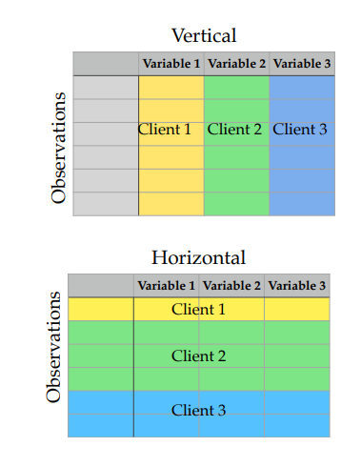
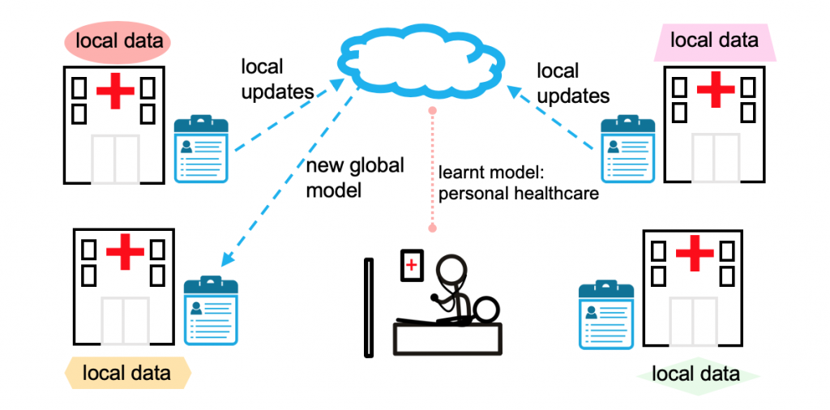
Overview
Li et al. (2020)

Slide 18


FL in the context of the Australian Cancer Atlas
Aim: Combine cancer datasets across states and countries
Inspiration: EuroCare - IKNL Netherlands
Open source
https://github.com/IKNL/ https://vantage6.ai/
atlas.cancer.org.au

Slide 19
Vantage6
EuroCare - IKNL Netherlands
Netherlands and Taiwan: prognostic factors for survival for oral cavity cancer patients – Federated Cox proportional hazards algorithm for horizontally-partitioned data (Lu et al. 2015, WebDisco)
Dutch Cancer Agency and National Registry: structured reporting positive for patient survival – Federated logistic regression for vertically-partitioned data (Li et al. 2015, VERTIGO)
Netherlands and Italy: survival of rectal cancer patients – Federated implementation of the chi-squared test

Slide 20




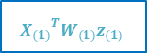
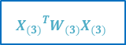
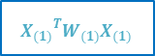
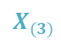

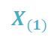

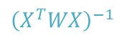
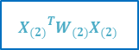
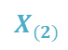
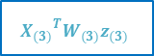
$$X_{(1)}$$
$${X_{(1)}}^{T}W_{(1)}X_{(1)}$$
$${X_{(1)}}^{T}W_{(1)}z_{(1)}$$
β
$$X_{(2)}$$
$${\left(X^{T}WX\right)}^{−1}$$
$$X^{T}Wz$$
$${X_{(2)}}^{T}W_{(2)}X_{(2)}$$
$${X_{(2)}}^{T}W_{(2)}z_{(2)}$$
$$X_{(3)}$$
$${X_{(3)}}^{T}W_{(3)}X_{(3)}$$
$${X_{(3)}}^{T}W_{(3)}z_{(3)}$$

Slide 21
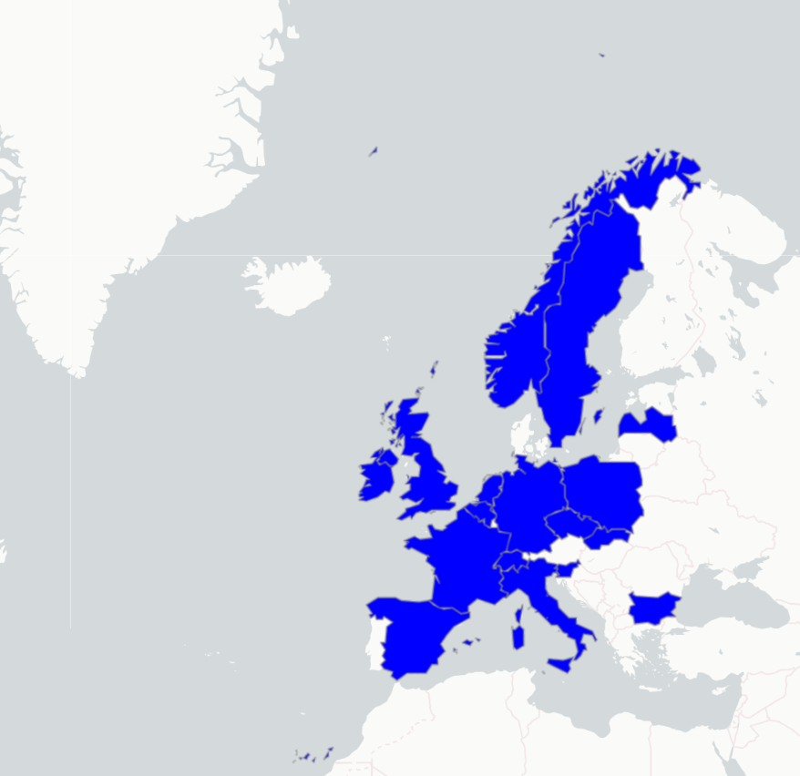
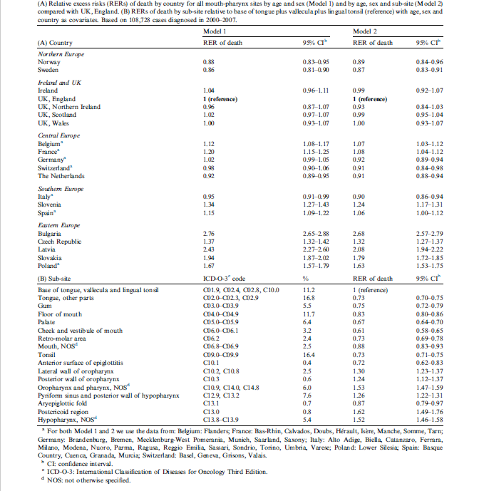













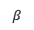
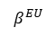
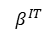
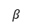
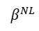
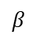
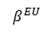
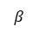
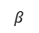
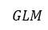
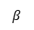
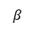
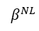
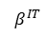
EUROCARE-5 original
EUROCARE-5 federated
$$β$$
$$β$$
$$β$$
$$β$$
$$β$$
$$β$$
$$β$$
$$β$$
$$β$$
$$β$$
$$β$$
$$β$$
$$GLM$$
$$β^{NL}$$
$$β^{NL}$$
$$β^{NL}$$
$$β^{EU}$$
$$β^{EU}$$
$$β^{EU}$$
$$β^{IT}$$
$$β^{IT}$$
$$β^{IT}$$

Slide 22
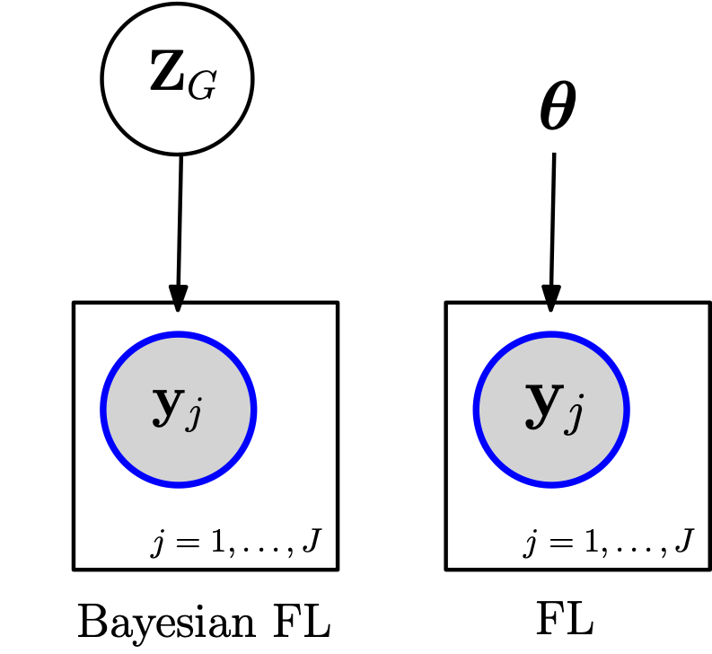
Current FL - open question
e.g., distributed MCMC methods, Laplace approximations for GLMs
Currently, only limited types of models are possible. Common models currently include:
GLMs
Gaussian processes
Neural nets
None of these models naturally have silo-specific variables.
Can we fit generic structured probabilistic models in the FL setting?
Can we accommodate heterogeneous data and partially siloed data?
e.g., MLE estimation of GLMs, training of neural nets

Slide 23
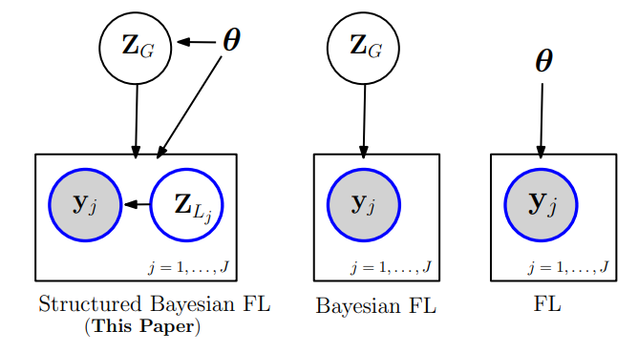
FL: Hierarchical spatial model (horizontal data)
Current approaches:
Same parameters for each party
e.g., GLM
Our interest: Bayesian structured models
hierarchical / mixed effects models, person or area-level random effects, fully or partially pooled regression, temporal effects, disjoint spatial random effects
Estimation: Variational Inference

Slide 24
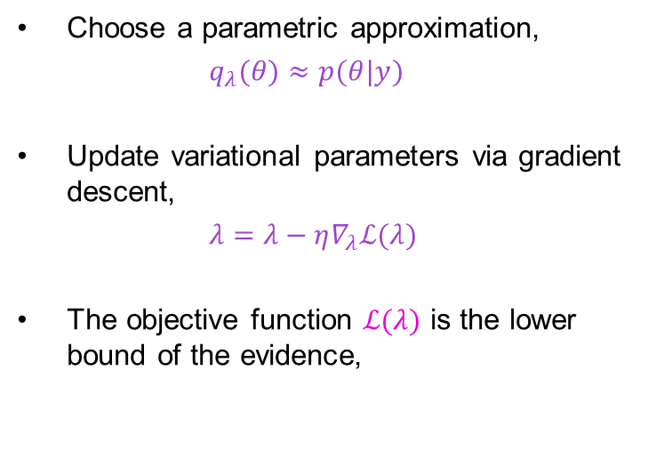
Variational inference
True posterior distribution
Closest approximate posterior distribution
Gaussian VI in a nutshell
Choose a parametric approximation,
$q_{λ}(θ)≈p(θ|y)$
Update variational parameters via gradient descent,
$λ=λ−η∇_{λ}ℒ(λ)$
The objective function $ℒ(λ)$ is the lower bound of the evidence,
$$ℒ(λ)=𝔼_{q_{λ}\left(θ\right)}[log p(θ|y)−log q_{λ}(θ)]$$
Space of all possible approximate posterior distributions given variational family
Space of all possible posterior distributions

Slide 25
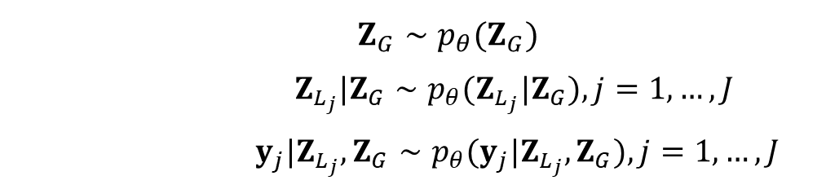
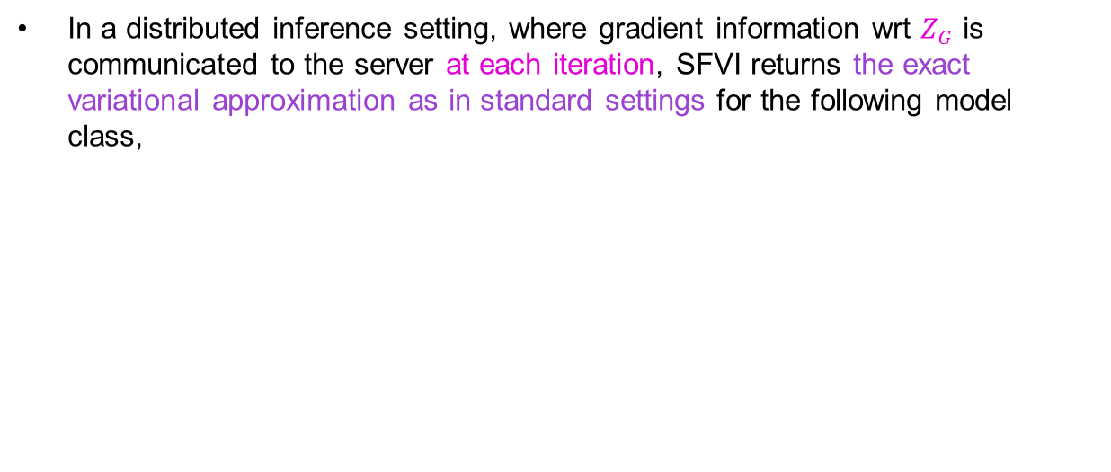
Structured Federated Variation Inference (SFVI)
Properties of the choice of approximation
In a distributed inference setting, where gradient information wrt $Z_{G}$ is communicated to the server at each iteration, SFVI returns the exact variational approximation as in standard settings for the following model class,
Model classes that this includes are,
Bayesian hierarchical models
Topic models
Hierarchical VAEs
…
$Z_{G}∼p_{θ}(Z_{G})$
$Z_{L_{j}}|Z_{G}∼p_{θ}(Z_{L_{j}}|Z_{G}),j=1,…,J$
$y_{j}|Z_{L_{j}},Z_{G}∼p_{θ}(y_{j}|Z_{L_{j}},Z_{G}),j=1,…,J$

Slide 26
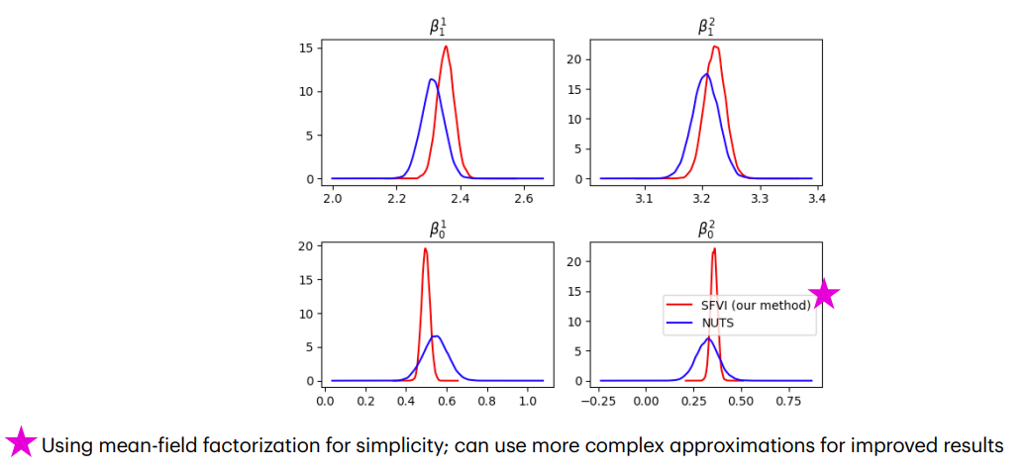
FL Example: Results

Slide 27
2. The challenge of complete data
Cancer risk data often obtained from surveys
2017-18 Australian Bureau of Statistics (ABS) National Health Survey (NHS) ≈ 17,000 adults
Small sample size – small area (SA2) sample size of 8 (IQR: 5–13)
Samples for ≈ 70% of areas (non-random)
~ 50% of SA2 are either nonsampled or unstable
Current small area estimation methods for proportions:
Individual-level models
Require covariate data for all population individuals
Cannot use survey-only covariates
Adjusts for sample design via modelling rather than sample weights
Area-level models
With very small sample sizes → unstable direct estimates
Insufficient understanding of performance for non-sampled areas

Slide 28
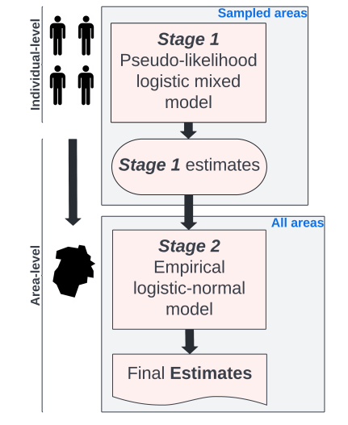
Two-stage model
Increased stability
Increased smoothing
Increased coverage

Slide 29
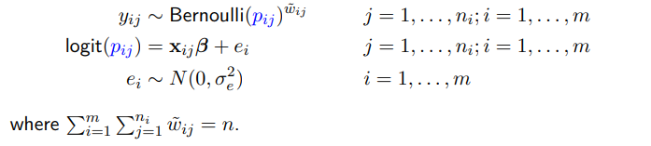
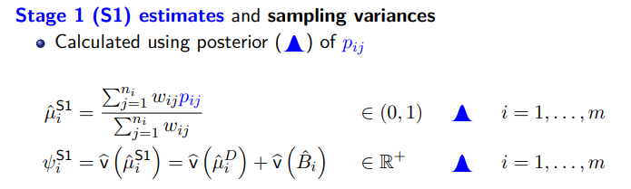
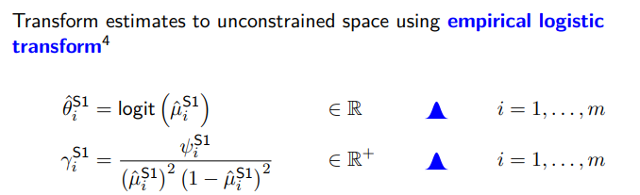
Stage 1 model (individual level)
X includes individual-level (chronic illness, other risk factors, etc) and area-level covariates (median income, employment rate, etc)

Slide 30
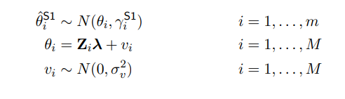

Stage 2 model (area level)
Z includes census variables for all areas

Slide 31

Application to ACA – Survey areas
5 risk factors:
Smoking
Alcohol
Diet
Weight
Physical activity

Slide 32


ACA – Stage 1 model + Stage 2 model

Slide 33

ACA – Results

Slide 34

ACA – Open results: Estimated proportions

Slide 35

ACA – Open results: Uncertainty

Slide 36

ACA – Open results: Pr(exceed national average)

Slide 37

3. The challenge of interpretable data

Slide 38

Visualisation: Communicating uncertainty – wave plot

Slide 39

Added value: Clustering
Approaches (Wala Areed)
Spatial Gaussian mixture
Spatial Dirichlet mixture

Slide 40
Conclusion
Digital platforms can be effective conduits for open data
Open data challenges addressed by the Australian Cancer Atlas:
Private Data Spatial models, Federated learning
Complete Data Two-stage model
Interpretable Data Visualisations, inferences (e.g., clustering)

Slide 41

Conclusion: “So what?”

Slide 42
References
Duncan E, Cramb S, Baade P, Mengersen K, Saunders T, Aitken J. (2020) 'Developing a Cancer Atlas using Bayesian Methods: A Practical Guide for Application and Interpretation' (Available here)
Hassan C, Salomone R, Mengersen, K. (2023) Federated Variational Inference Methods for Structured Latent Variable Models. (ArXiv)
Hogg J, Cameron J, Cramb S, Baade P, Mengersen K. (2023) 'A two-stage Bayesian small area estimation method for proportions' (ArXiv)
Areed W, Price A, Arnett K, Thompson H, Malseed R, Mengersen K. (2023) 'Assessing the spatial structure of the association between attendance at preschool and children’s development vulnerabilities in Queensland, Australia', PLOS ONE (Available here)

